Slide 1
A Program for planning
and maintenance management
WWW.PROFYLAX.CZ

Slide 2
THE BENEFITS OF PROFYLAX
All information quickly available
All maintenance information will be clearly arranged in one place in one database.
make maintenance decisions from controlled data → reduce machine downtime → increase productivity
Maintenance planning
A comfortable calendar planning of preventive maintenance with the choice of manual intervention and supplementation.
Maintenance reports
A complete overview of realised maintenance (ISO audit!), repairs and their costs.$→$ lower maintenance costs.
Prints, statistics and capacity overview.
Prints for the ISO audit, statistics of capacity utilization and other prints for improving maintenance management and planning.

Slide 3
Are you afraid of deadlines?

Slide 4
A Program for planning and maintenance management
CMMS/EAM
Delphi, Windows, Android, NexusDB
ΠΡΟΦΥΛΑΧ
CMMS (computerized maintenance management systems) / EAM (enterprise asset management)
The installation is easy and does not necessarily require any implementation assistance.
Profylax –
Your outpost.
System management
Compatibility
Prophylaxis

Slide 5
Records
Machines, tools, property, maintenance, materials, costs, orders…
What
DO we
offer?
Modules
Stock, Order, Diagnostics, Job orders…
MobiPFX a SmartPFX
Mobile application for Android and Windows

Slide 6
Maintenance costs
Average maintenance costs and possibility of savings.
Current trend
Excel has many useful functions, but it will never replace CMMS / EAM SW
WHY PROFYLAX?
Costs
CMMS/EAM
Maintenance costs are approximately 10 % of the total turnover of the company.
These systems can reduce maintenance costs by 10-15%.
TOTAL TURNOVER 1 000 000 000 Kč
MAINTENACE 100 000 000 Kč
SAVINGS 15 000 000 Kč
PROFYLAX is a powerful CMMS system (computerized maintenance management systems) / EAM (enterprise asset management), with implemented modules such as Stock, Order, Diagnostics, Job orders and more. It is designed for companies which need to plan and manage the maintenance of machines and other maintenance units. PROFYLAX is a Czech product on the market since 2004. The development of PROFYLAX is continuous and we constantly strive to respond to the requirements of our customers. As a result, we have become a major competitor of significantly more expensive foreign maintenance systems, as evidenced by more than 250 installations not only in the Czech Republic and Slovakia.

Slide 7
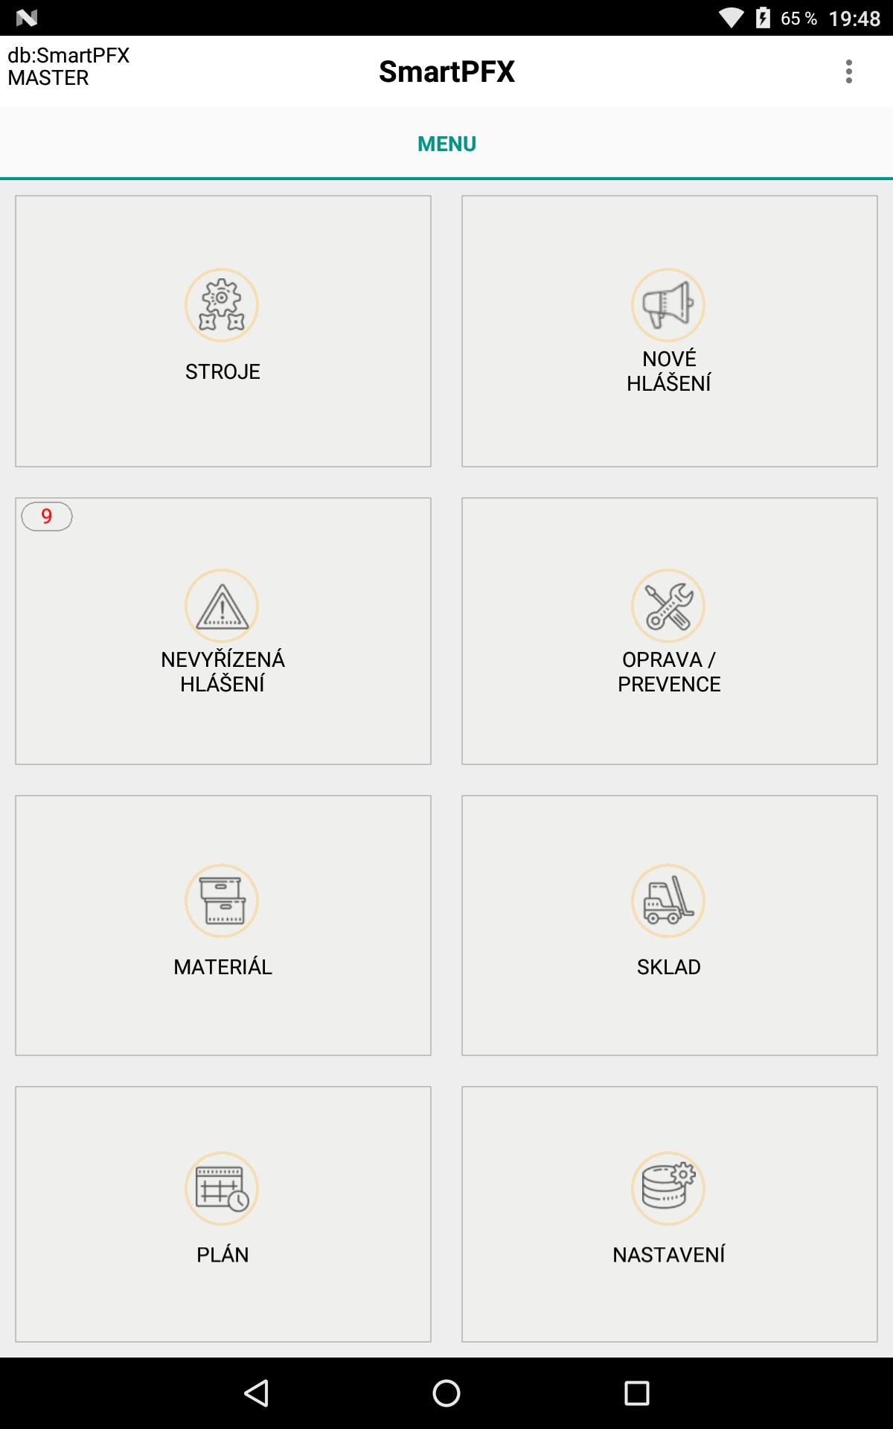
SmartPFX
MobiPFX
PROFYLAX
always at hand
Machine/tool card
Overview of machines, reports, repairs, diagnostics and plans.
QR-codes
Quickly create reports, record corrections and material movements via QR-codes.
Don't want to leave work in progress? Have PROFYLAX on your phone at all times!
Plan, Stock, Materials
Do you need an off-line solution for work outside your data network or Wi-Fi? You can use MobiPFX on your tablet or computer!
Everything clearly and quickly - always at hand.

Slide 8
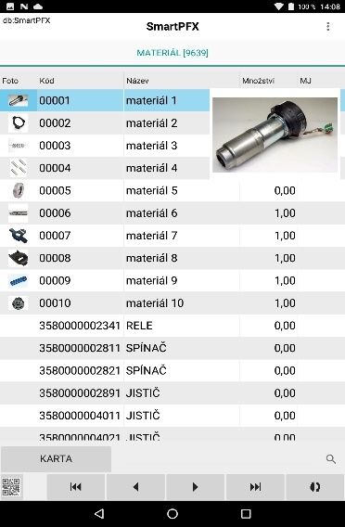
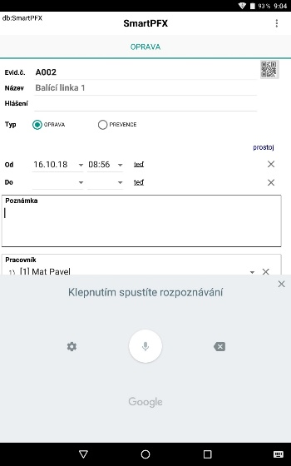
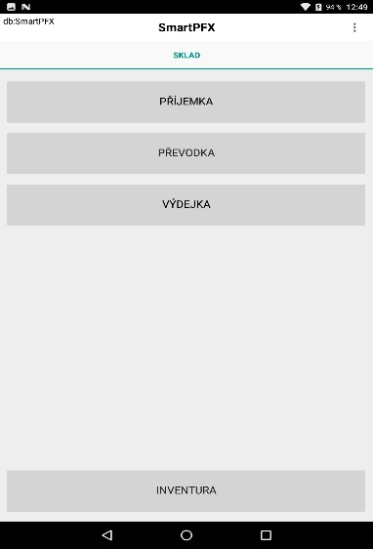
Quickly, elegantly and always at hand.
The application for mobile online work is available for Windows and Android. This means that the application can be operated on common mobile phones.
Overviews
Let the application work for you.
Spare parts
Complete overview of spare parts
Repairs
Quick record of corrections, revisions, reports etc.
Stock
Incomes, releases and transfers directly on your mobile.

Slide 9
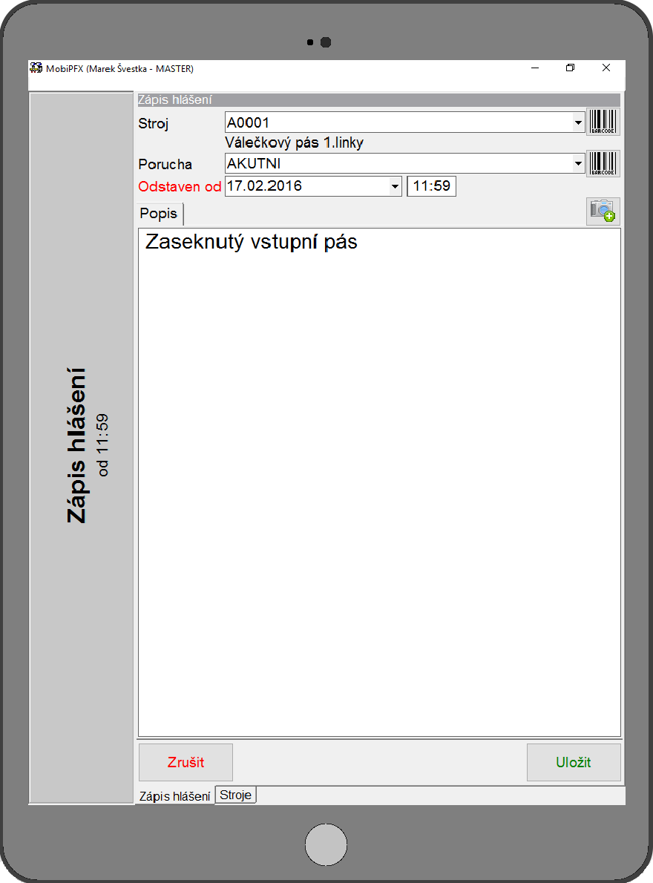
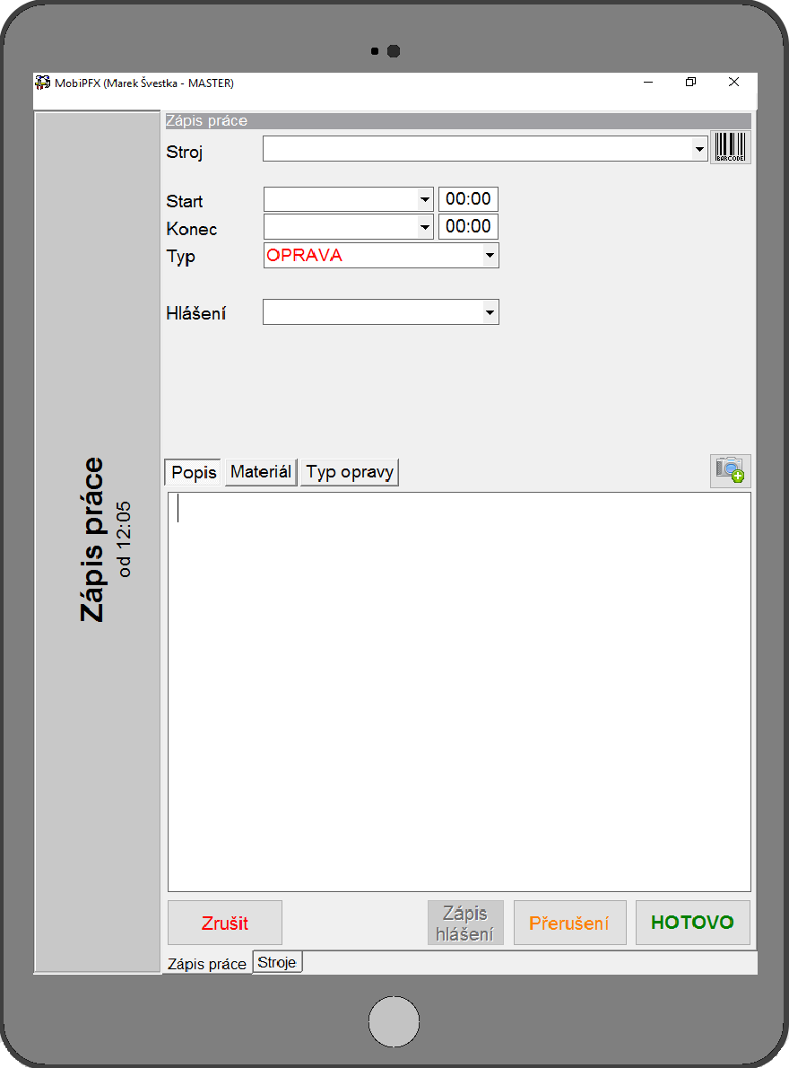
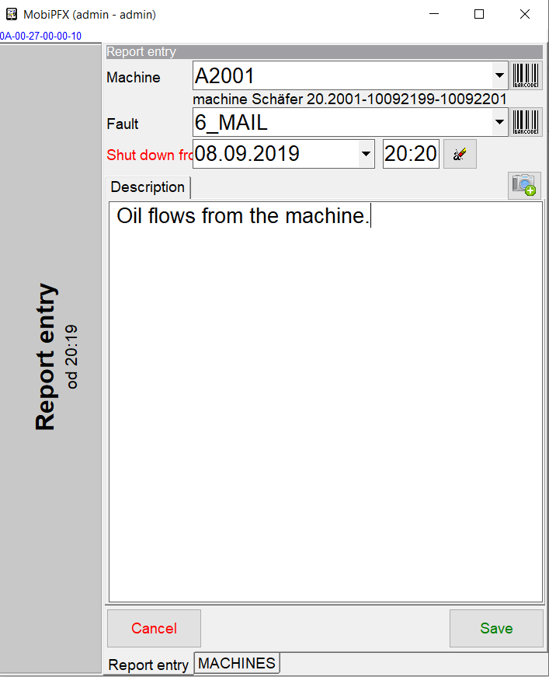
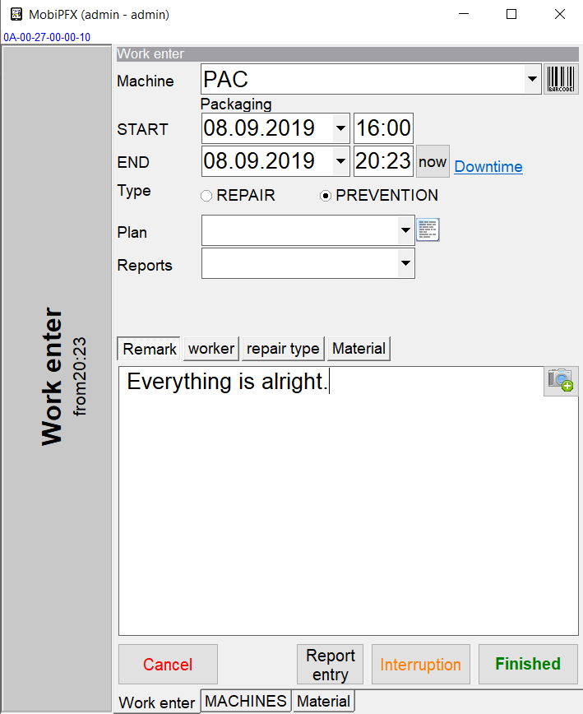
Quickly, elegantly and always at hand.
Off-line application is chosen by businesses when Wi-Fi coverage is not perfect, or when there is no signal at all in a business.

Slide 10
MENU
MAIN MENU
Machines; Hier.code.books Planning; Maintenance; Diagnostics; Workers; Partners; Stock; Order; Job orders; Prints/graphs; Param; Service.
Personalization options
Look, language, item access, column arrangement, filters, custom parameters, notifications…

Slide 11
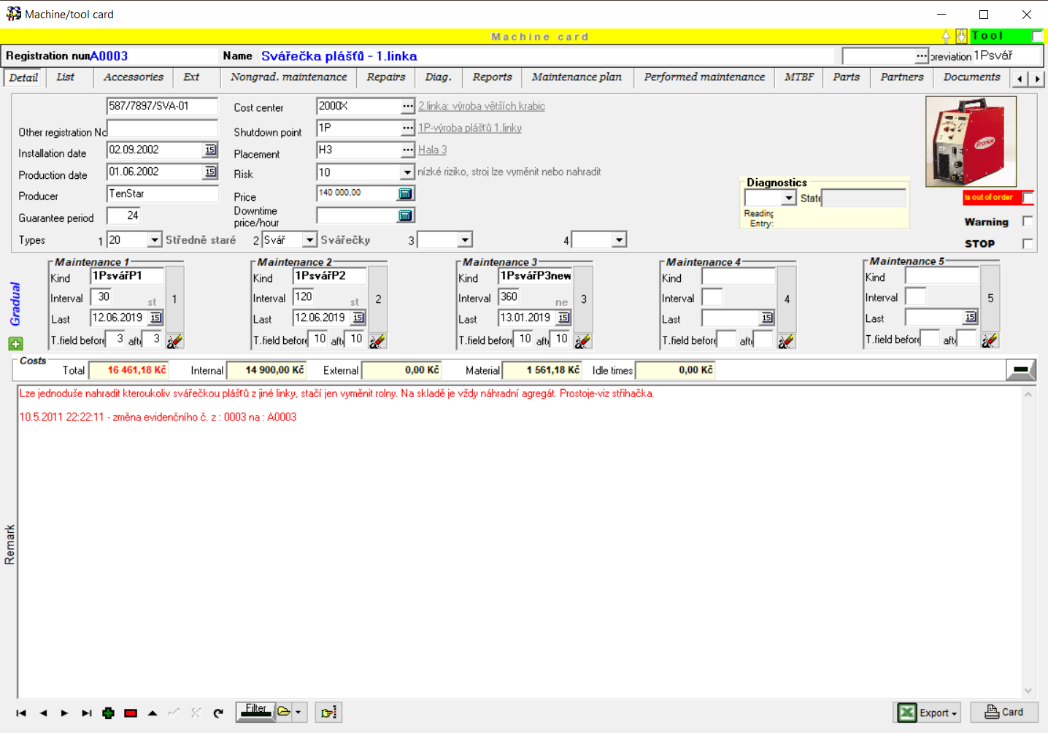
MACHINE / TOOL CARD
Machine / tool card
The machine is a basis of the maintenance database. The basic information is stored here. The whole tool card is clearly conceived with the help of tabs, where each tab includes certain integrated information about the machine.
Tabs of machine card
Detail; List; Accessories; Ext; Nongrad. Maintenace; Repairs; Diagnostics; Reports; Maintenance plan; Performed maintenance;
MTBF; Parts; Partners;
Documents; Photo; BOZP

Slide 12
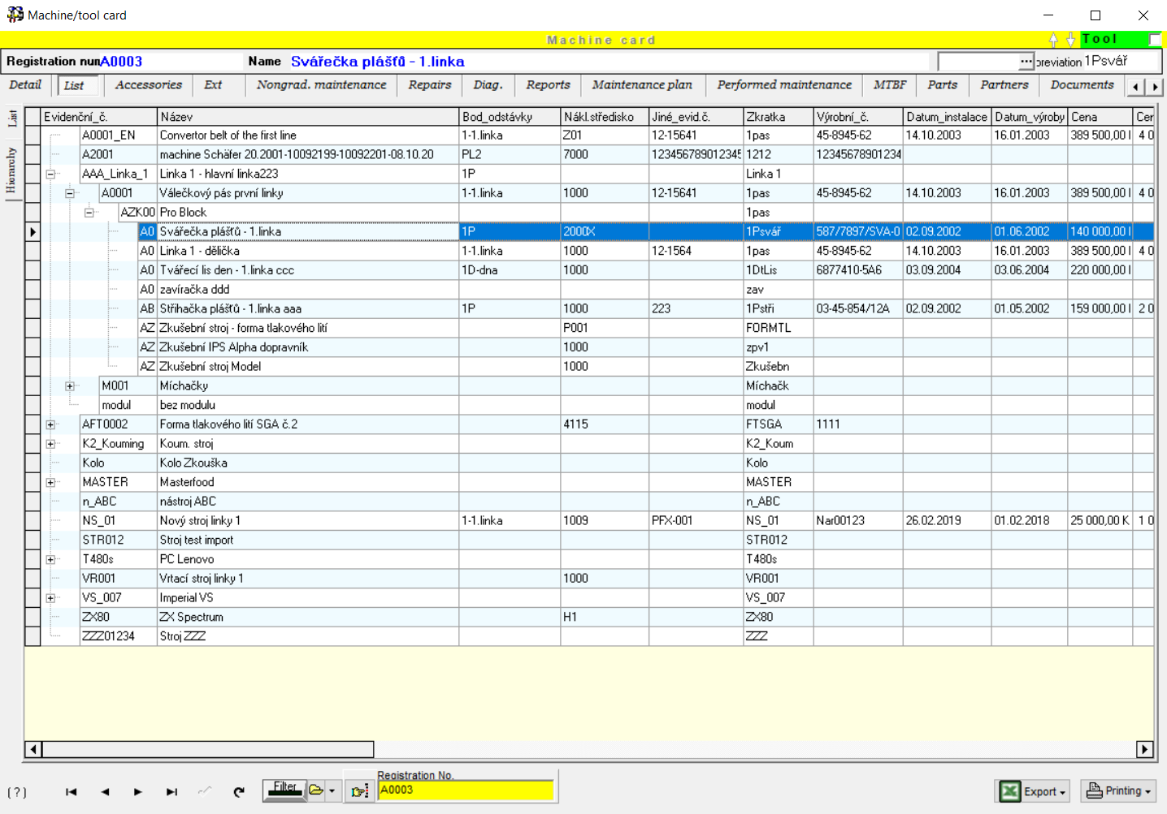
LIST / hierarchY
List / Hierarchy
In the List tab, basic information about the machine in a form of charts is displayed.
Adapting to your needs
Tables in the system could be customized to suit your preferences. Renaming columns, changing the order, font, font color, or hiding a column…

Slide 13
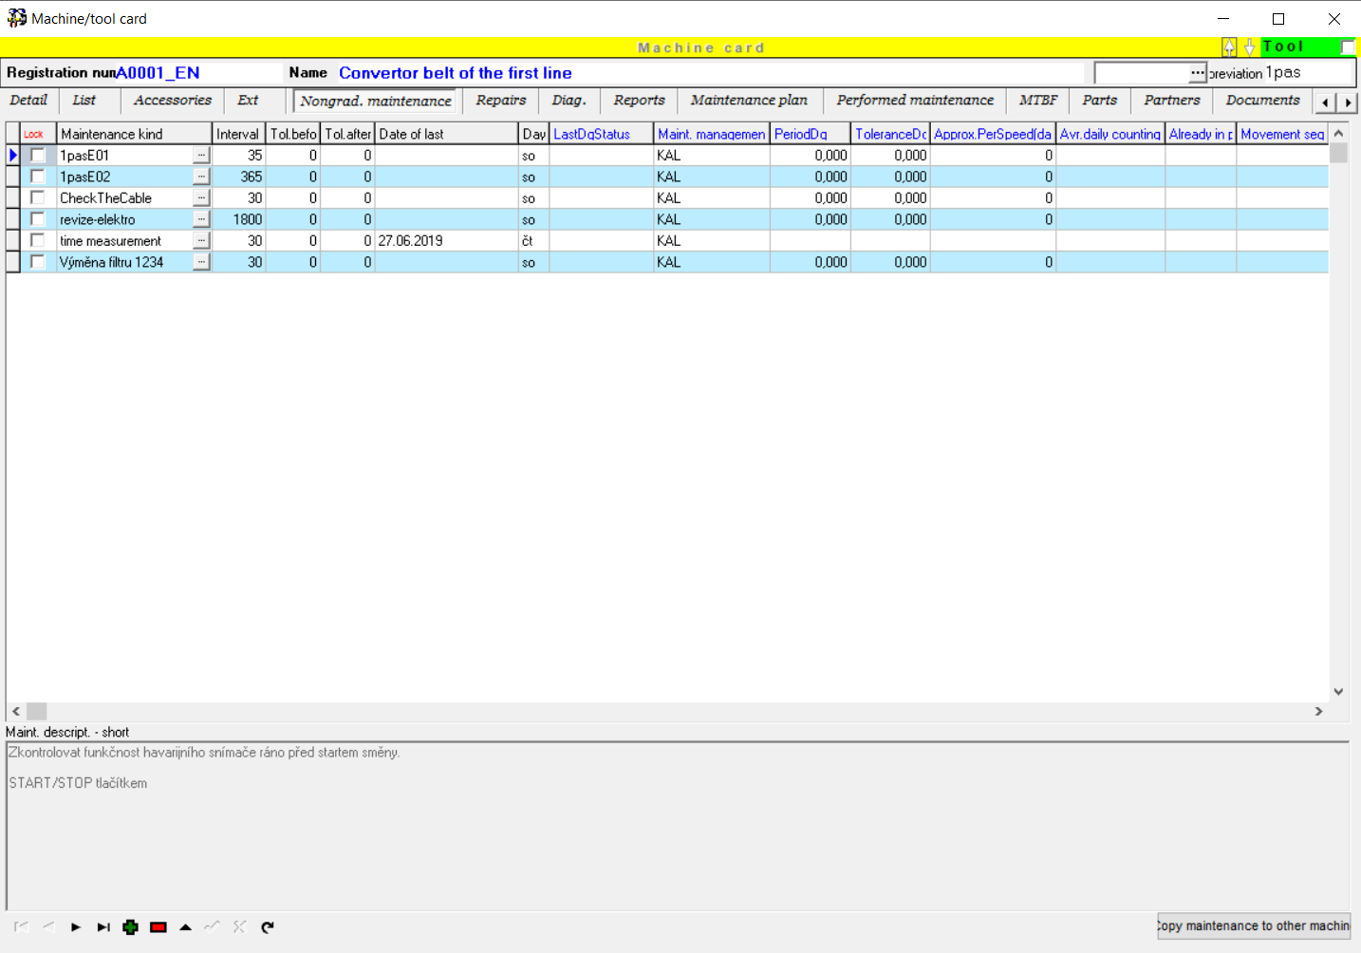
Unhierarchy maintenance
Unhierarchy maintenance
In the Nongradual maintenance tab there are defined independently repeatedly performed maintenances or single events such as revisions, trainings etc.
Possibilities of maintenance definition
Accurate maintenance is a key to success. Profylax offers hundreds of settings that make it possible for you to adapt everything to your needs.

Slide 14
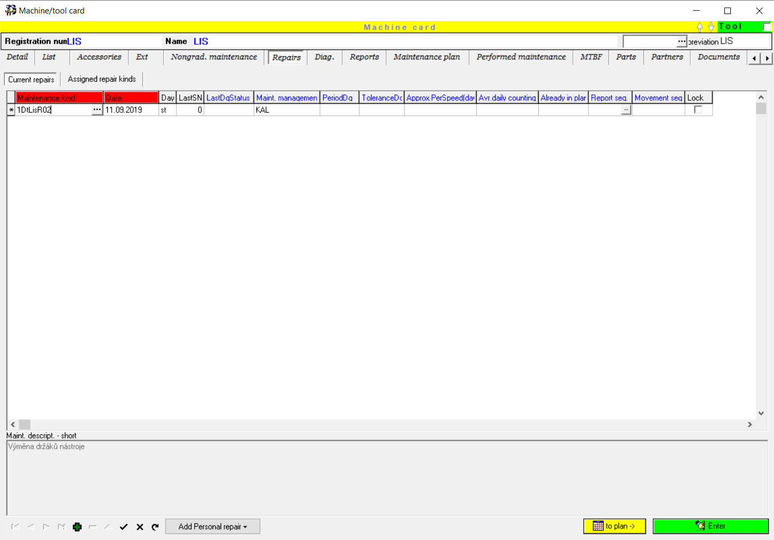
REPAIRS
Repairs
In the Repairs tab you fill in particular repairs of the machine.
How to write a repair
The procedure of the repair entry is as following:
1) repair entry
a) transfer of the repair into the maintenance plan
b) record of the repair implementation

Slide 15
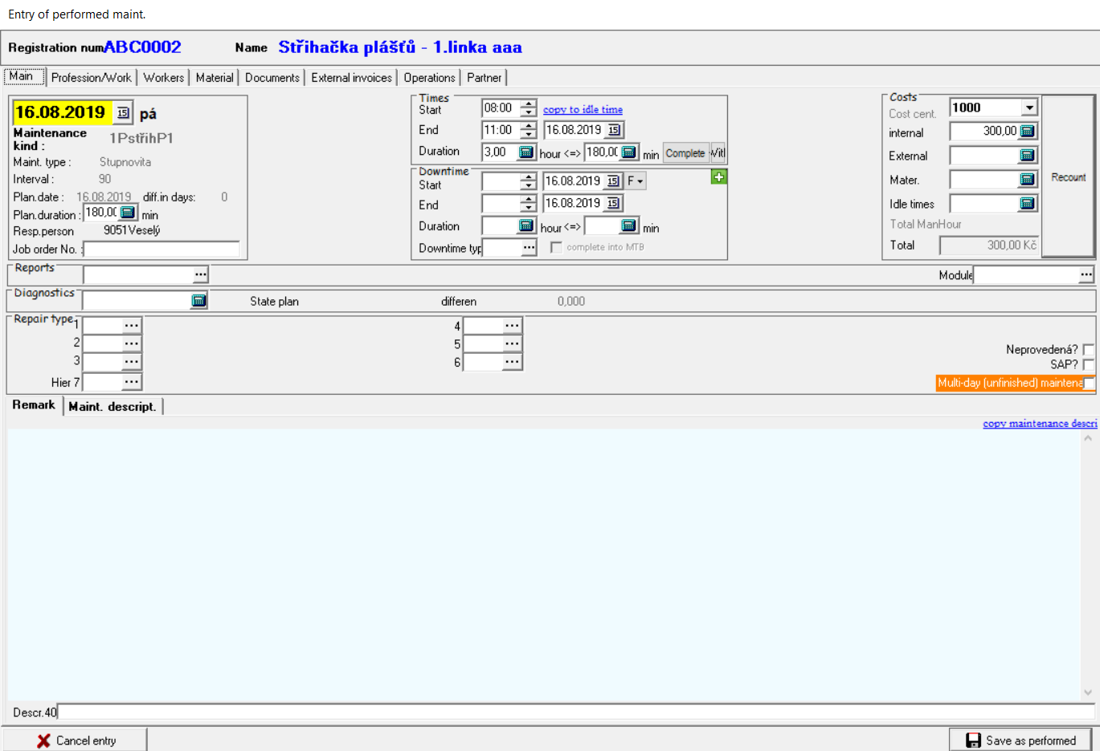
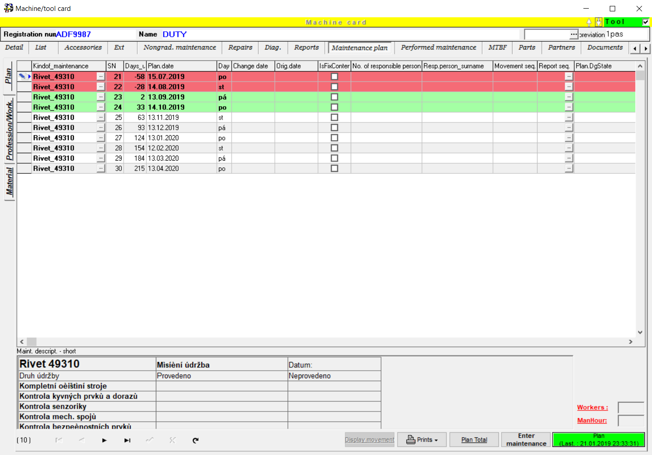
Maintenance plan/Maintenance entry
Overall plan or plan on the Machine Card
Clear maintenance plan with the possibility of highlighting according to urgency or degree of solution.
Write the final repair/maintenance
Possibility of writing a note, date, maintenance time, downtime, personnel, material used…

Slide 16
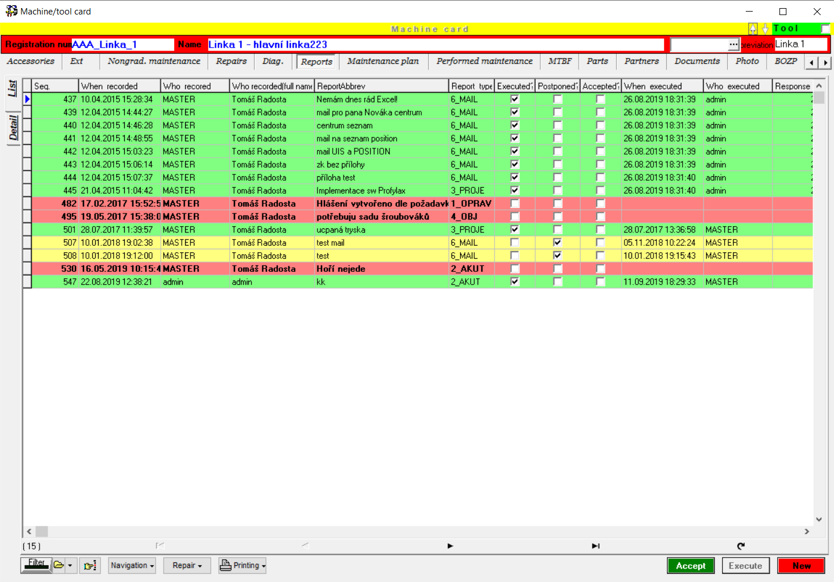
REPORTS
Machine reports
Here the users enter the defects and events online to a particular machine. After that the report can be adjusted. The Adjust button or just postponed for later.
Reports
Practical way of recording any event not only about the machines.

Slide 17
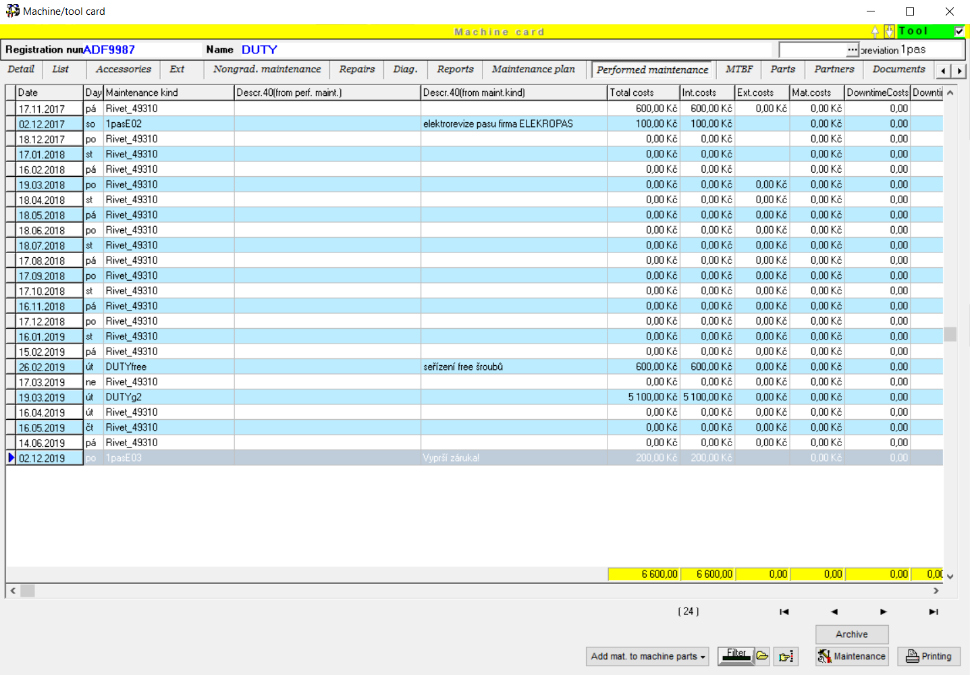
PERFORMED MAINTENANCE
Performed maintenance
The recorded and saved maintenance is already displayed in the Performed maintenance tab.
Overview of maintenance / repairs
All information about performed maintenance in one place.

Slide 18
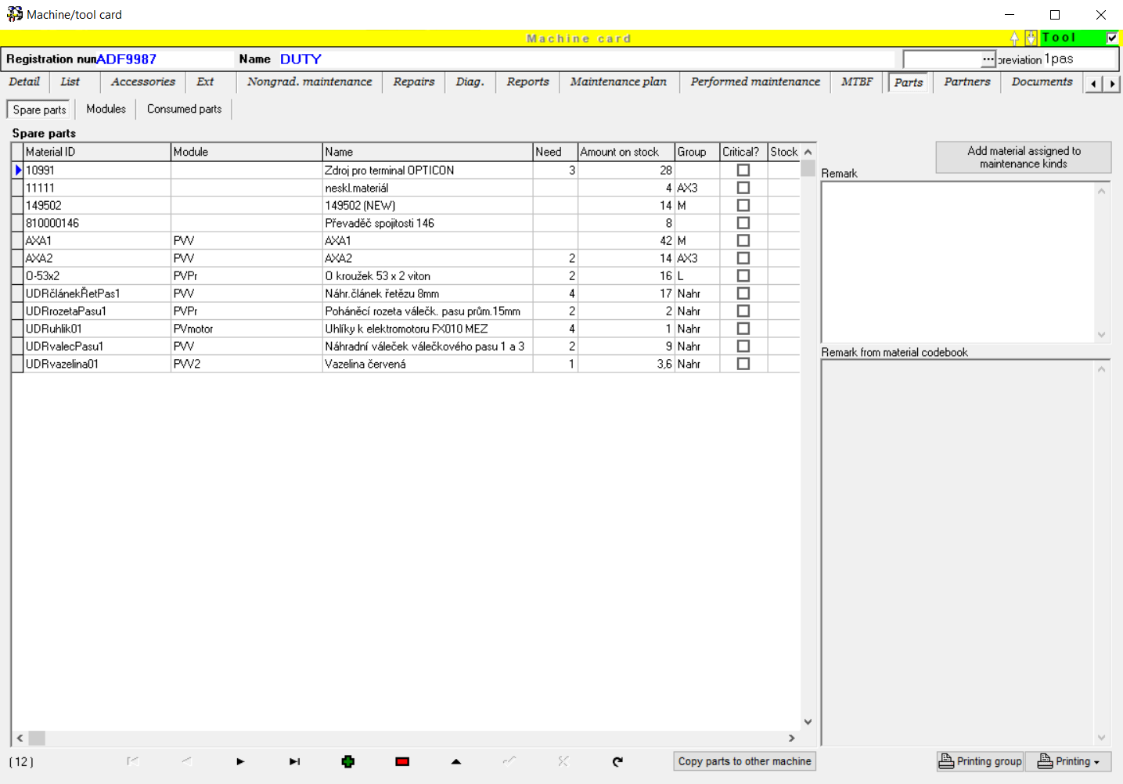
PARTS
Spare parts
Particular machines are composed of different parts, which themselves are not a subject of the maintenance. Individual parts can be assigned from the material list – from the stock.
Easy way of looking up spare parts.
This linked list is preferably offered for maintenance when selecting a spare part for repair.

Slide 19
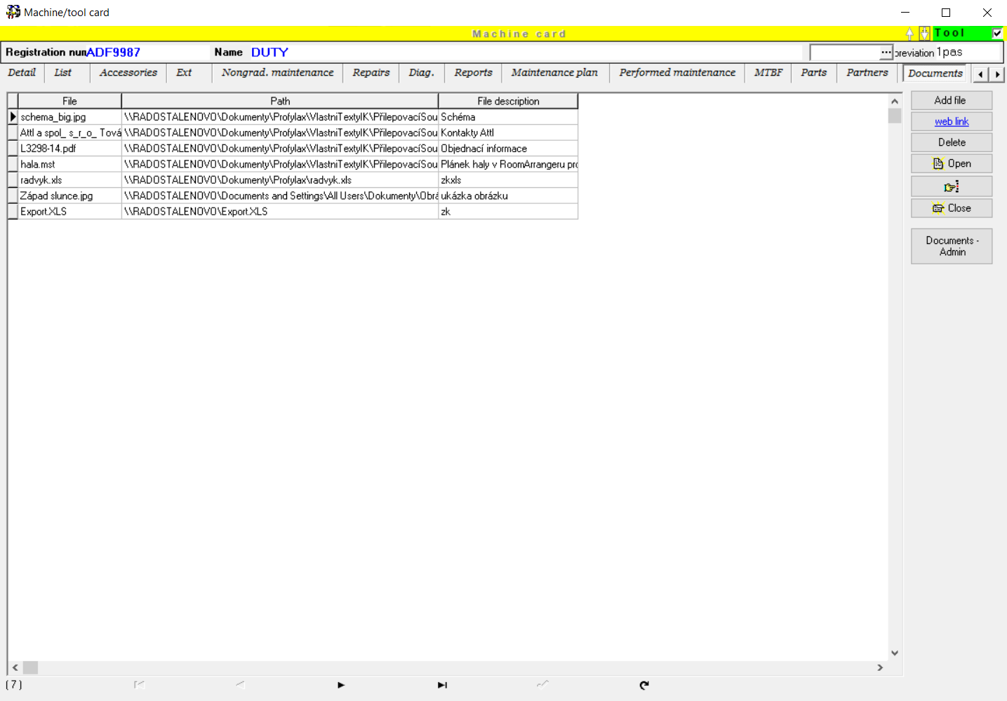
doCumentS
All documents at hand
You can attach necessary documents to particular machines (such as instructions, service documents, invoices etc.).
STOP searching for documentation.
Particular documents (word, excel etc.) can be opened and modified directly from the program.

Slide 20
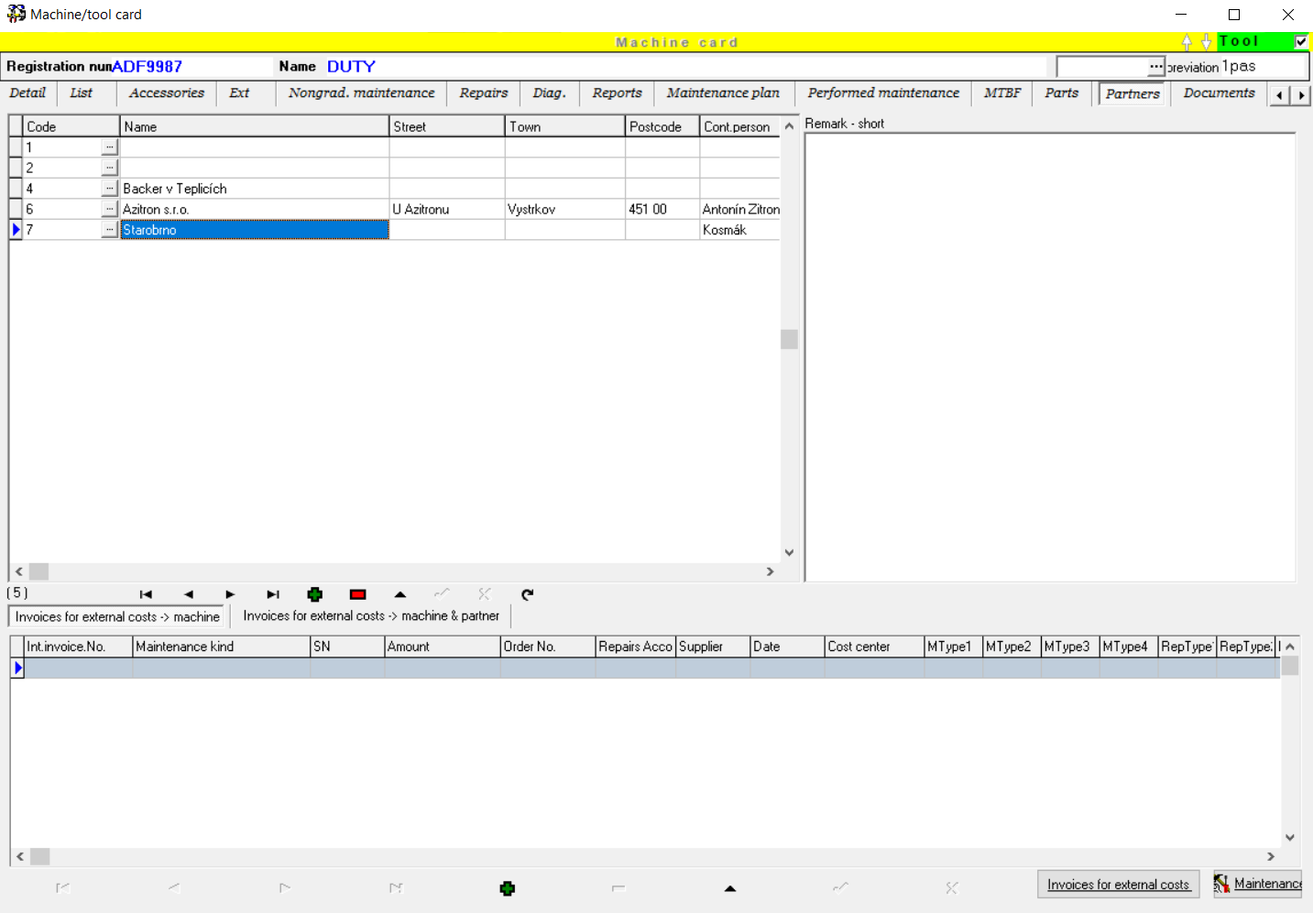
partneRS
Partners overview
The Partners tab is used to interconnect between particular partners with the machines (e.g. Suppliers of spare parts, servicemen…).
Who supplies us with spare parts?
All information about your company partners in one place.

Slide 21
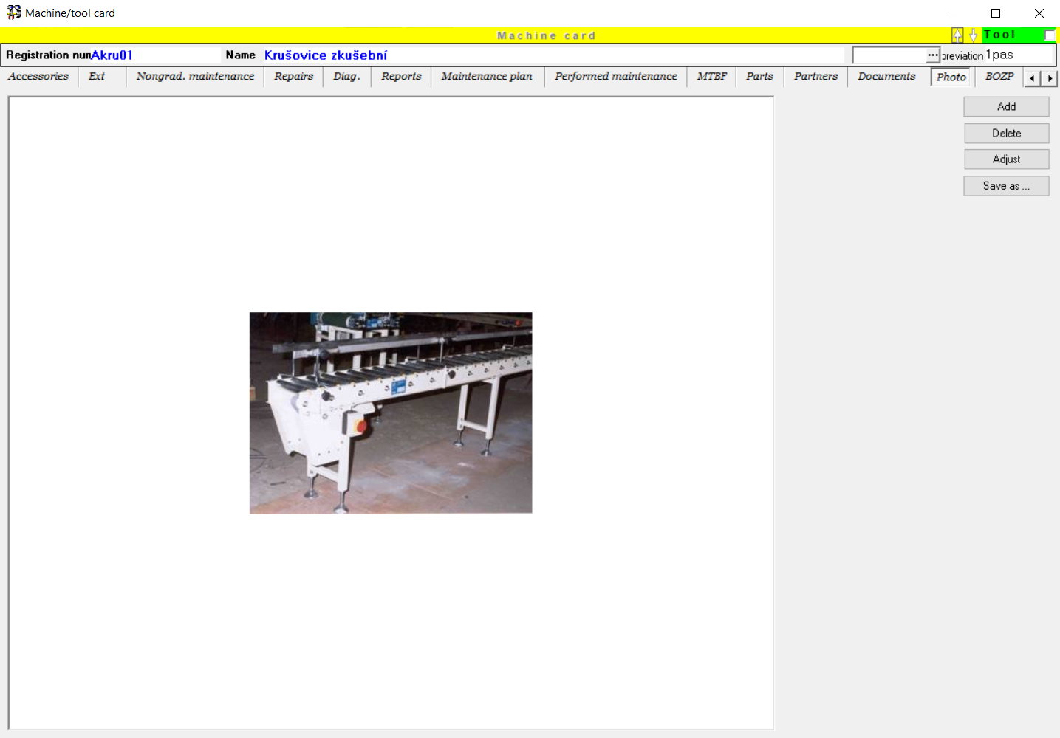
Photo
Photo of the machine
In the Photo tab you can attach a photography. It is an informative photo, which helps you with easier identification of a machine in the card.
Photography is sometimes better than words.
This photo is used to print a detailed machine card and can be printed with work orders.

Slide 22
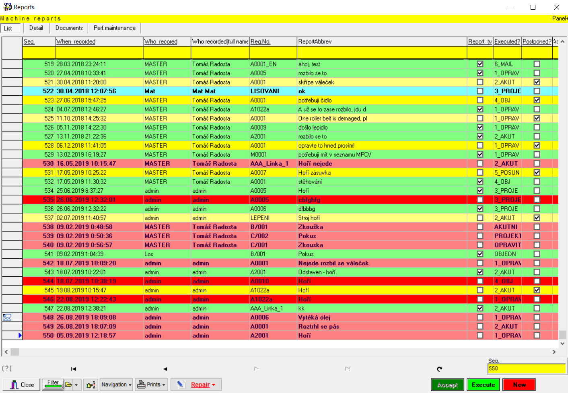
REPORTS
Report any event
Reports to the machines: the operators or maintenance men can immediately enter the requirements to the maintenance. The maintenance manager has an immediate overview and can gradually sort the reports according to their level of accomplishment.
Immediate overview of reporting status.
Anyone has an immediate overview of the current situation.

Slide 23
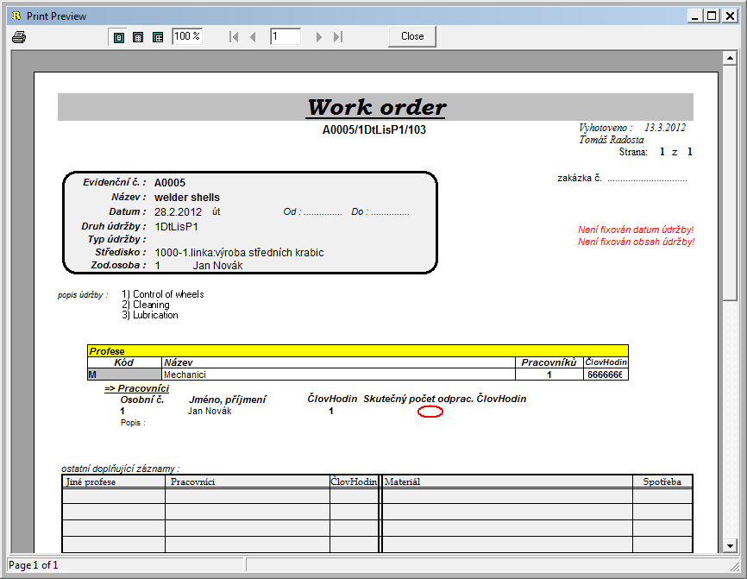
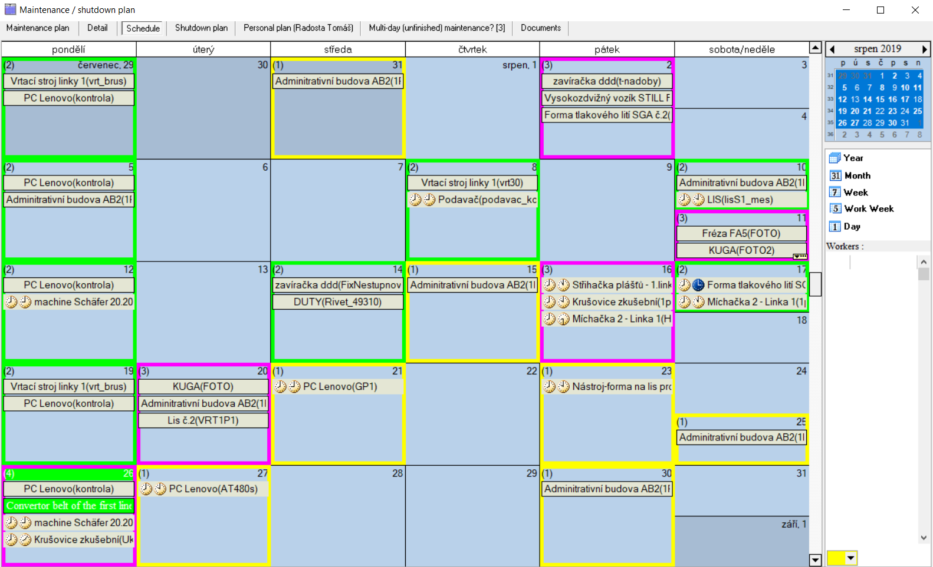
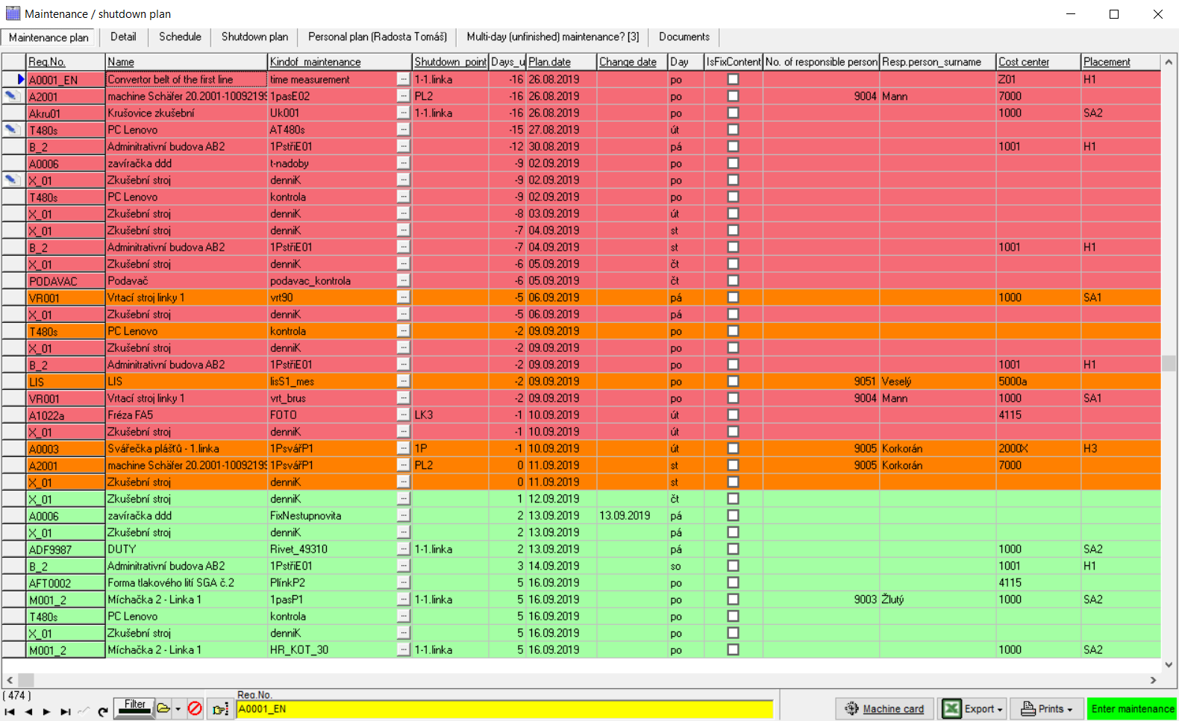
Automatic scheduling
PLANNING
PROFYLAX on the basis of machine card data you can create a maintenance plan and idle time schedule for selected periods. It will be displayed in the form of calendar or in detail as a table. In terms of planning is maintenance period, period tolerance and finally performed maintenance is essential. Planned actions can be manually moved to other dates and the change is included when planning again.
PROFYLAX will take care of you
The plan can be printed in various forms and for each action taken work order can be printed too.
When starting PROFYLAX will let you know about current maintenance and its timely preparation.

Slide 24
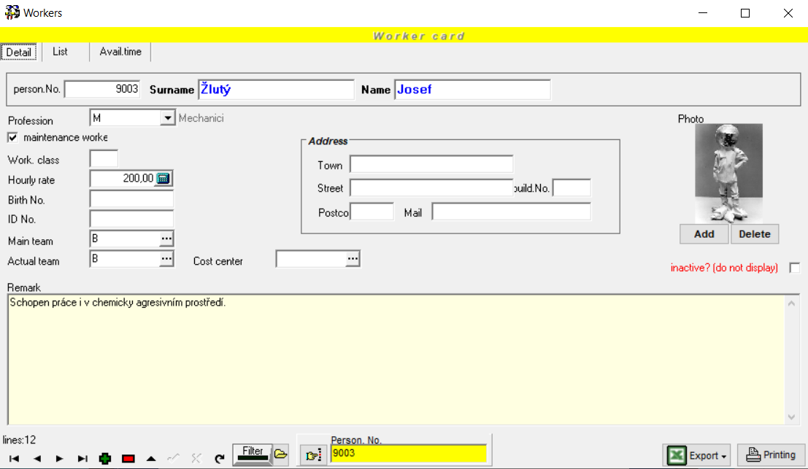
WORKERS
Records of workers
It serves to keep records of all workers who are involved in maintenance realization. These entered workers can be assigned to particular types of maintenance, to planned maintenance and especially to completed maintenance records.
Redistribution of work
Each worker should belong to a certain profession. In terms of maintenance capacity planning, firstly the workload of professions is important, then we can assign workers to work orders.

Slide 25
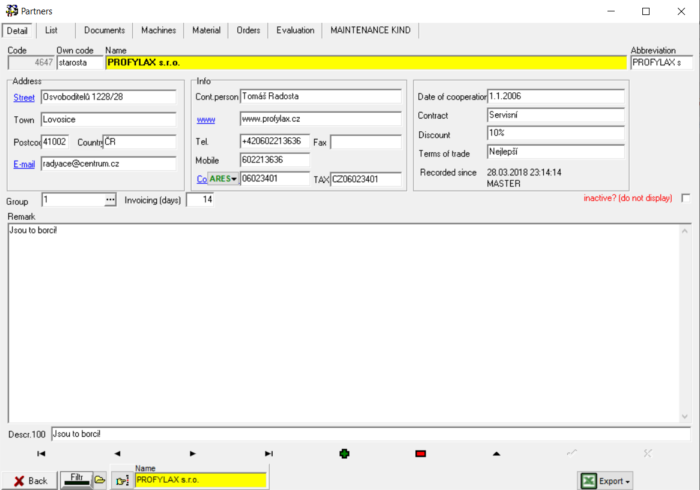
PARTNERS
PARTNERS
List of partners related to machines (e.g. suppliers of spare parts, service companies, overhauls).
Contacts quickly and clearly
Important contacts can be entered here so that they would be available for all, who need them. There is also e-mail and link to web at disposal. Moreover, documents (contracts) can be attached. Partners can be assigned to machines, by selection made from a list on machine card.

Slide 26
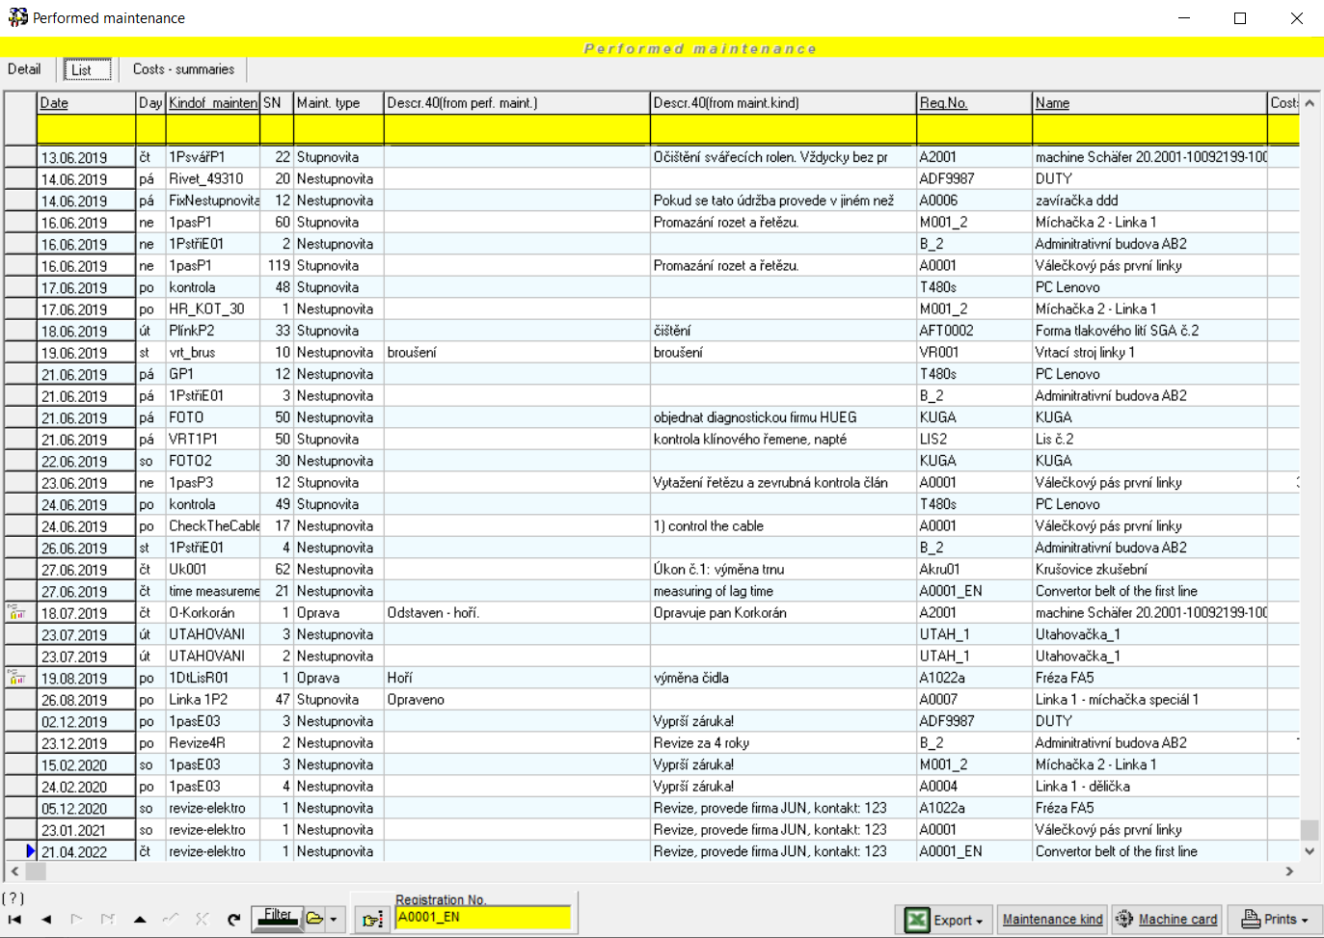
PERFORMED MAINTENANCE
Performed maintenance
Complete overview of all performed maintenance + repairs and related costs. Here you can see, how your machines followed the preventive maintenance intervals, what repairs were carried out with particular machines, occurred machine faults, for instance you can immediately find out who conducted the previous maintenance etc.
Stop nervousness before audits.
This is also a simple way of providing evidence of maintenance level for ISO audit. The record of performed maintenance is really simple, most often it is just transfer of work order into the form of completed maintenance, all with one click.

Slide 27
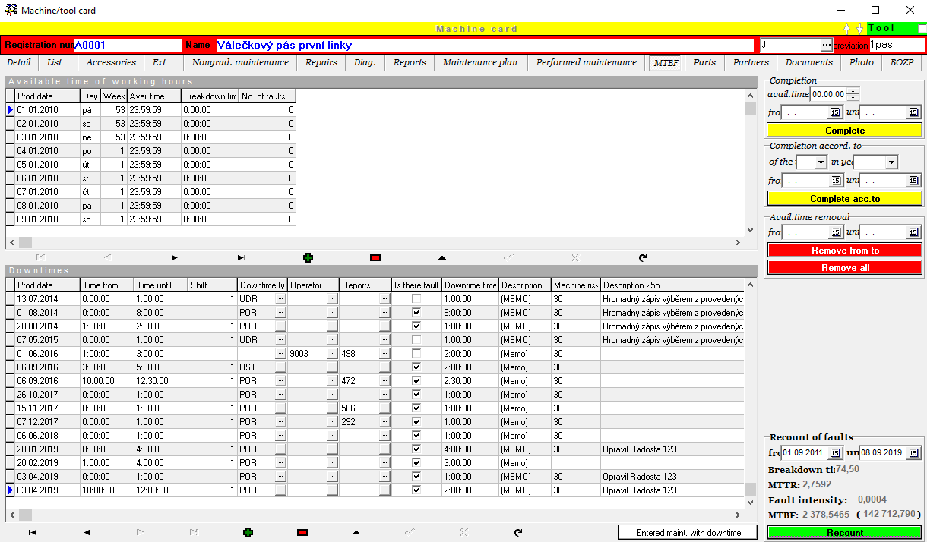
MTBF/MTTR
MTBF/MTTR
MTBF – Mean-Time-Between-Failure is also a metric for machine performance. It is the inverse of Failure Rate and is thus calculated from the same parameters. It is a meaningful metric for long periods of time but not suitable for daily or weekly monitoring.
MTTR - Mean-Time-To-Repair is another simple yet valuable metric for industrial maintenance. It reflects both the severity of breakdowns and the efficacy of repair activities.
How long does the
calculation take?
One-touch calculations. Everything in a few seconds.

Slide 28
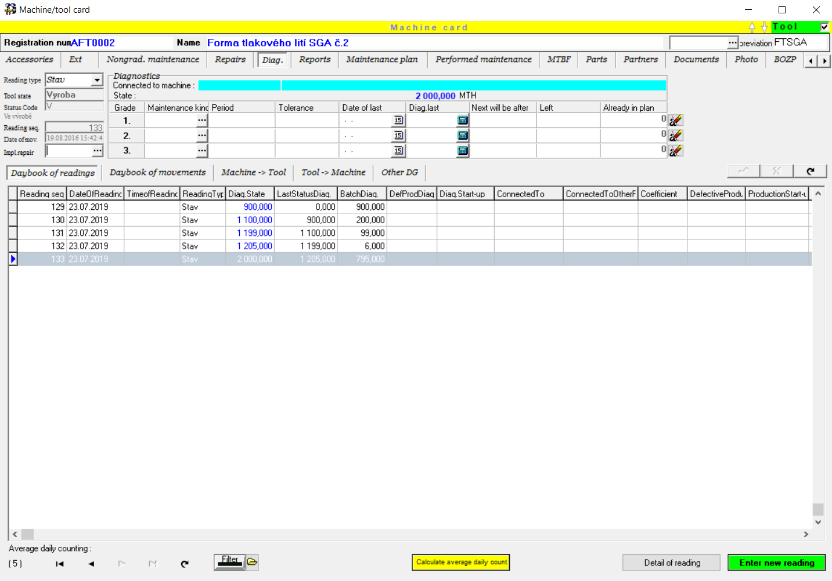
DIAGNOSTICS
Diagnostics maintenance management
With the help of a special module you can control the tool and form maintenance according to the number of moldings, castings etc. (a maintenance according to diagnostics).
Diagnostics
In the daybook you fill in the diagnostics subtracts to the machines or the subtracts are overtaken by the file from the automatic counters.
The evidence of machines movements – which tool was attached to which machine (press) and how many lifts has it done, when was it put into the stock or repaired.

Slide 29
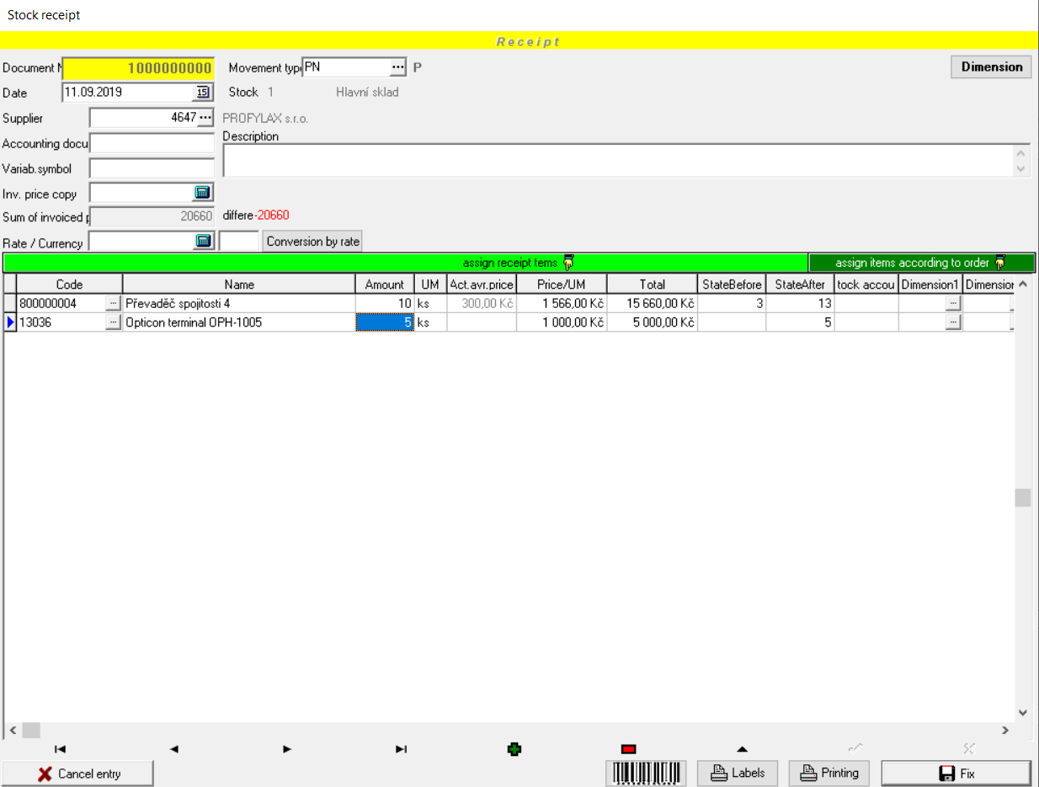
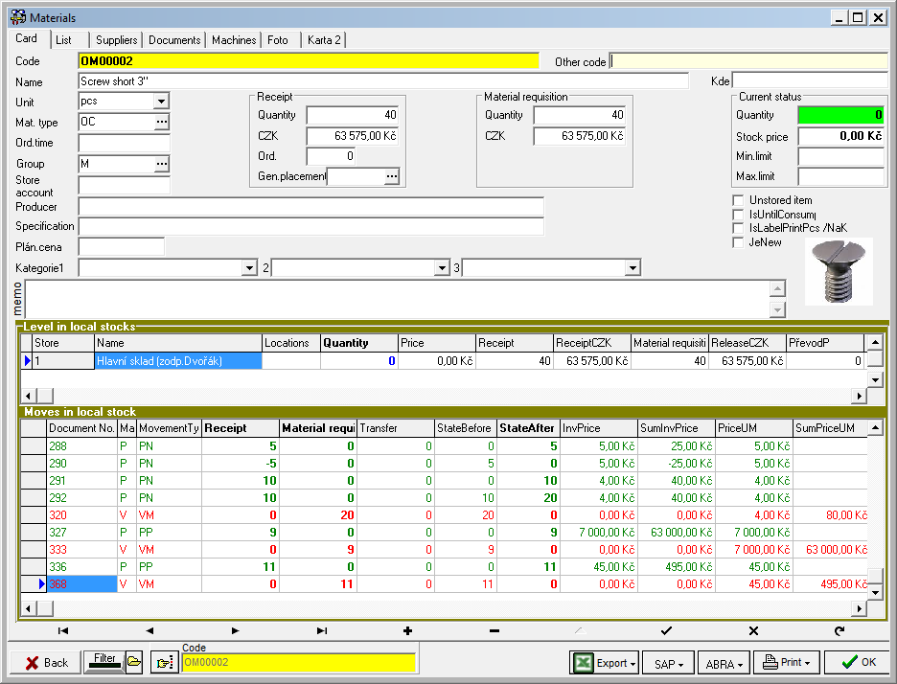
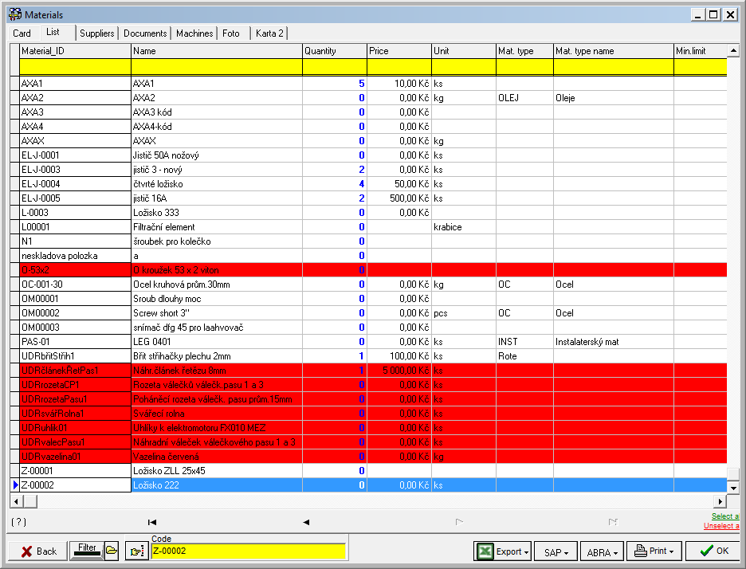
STOCK
STOCK
The maintenance stock is usually administered within central stock control. Then, in Profylax you simply keep a code list of selected items and we will just connect Profylax to your stock. If you wish to control maintenance stock directly in Profylax, we have separately licensed module STOCK for you.
What can this module do?
records of more local stocks, issue receipt, release and transfer notes. When entering performed maintenance, a release note of consumed material assigned to maintenance is automatically created.

Slide 30
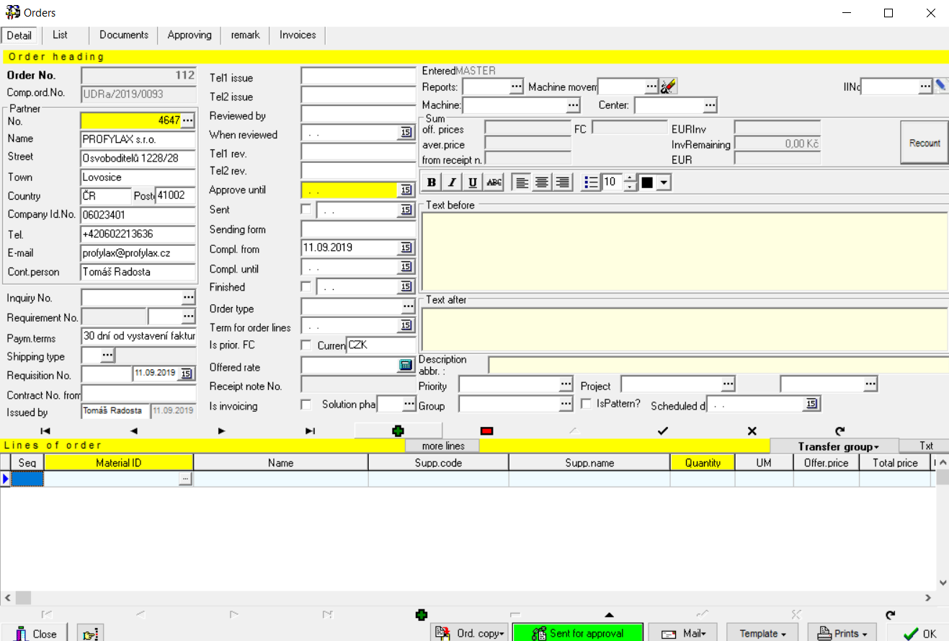
ORDERS
Orders
To make an order spare parts directly in Profylax, we have a separately licensed module ORDERS.
Orders directly from PROFYLAX
It allows you to define electronic order approvals and order directly from PROFYLAX

Slide 31
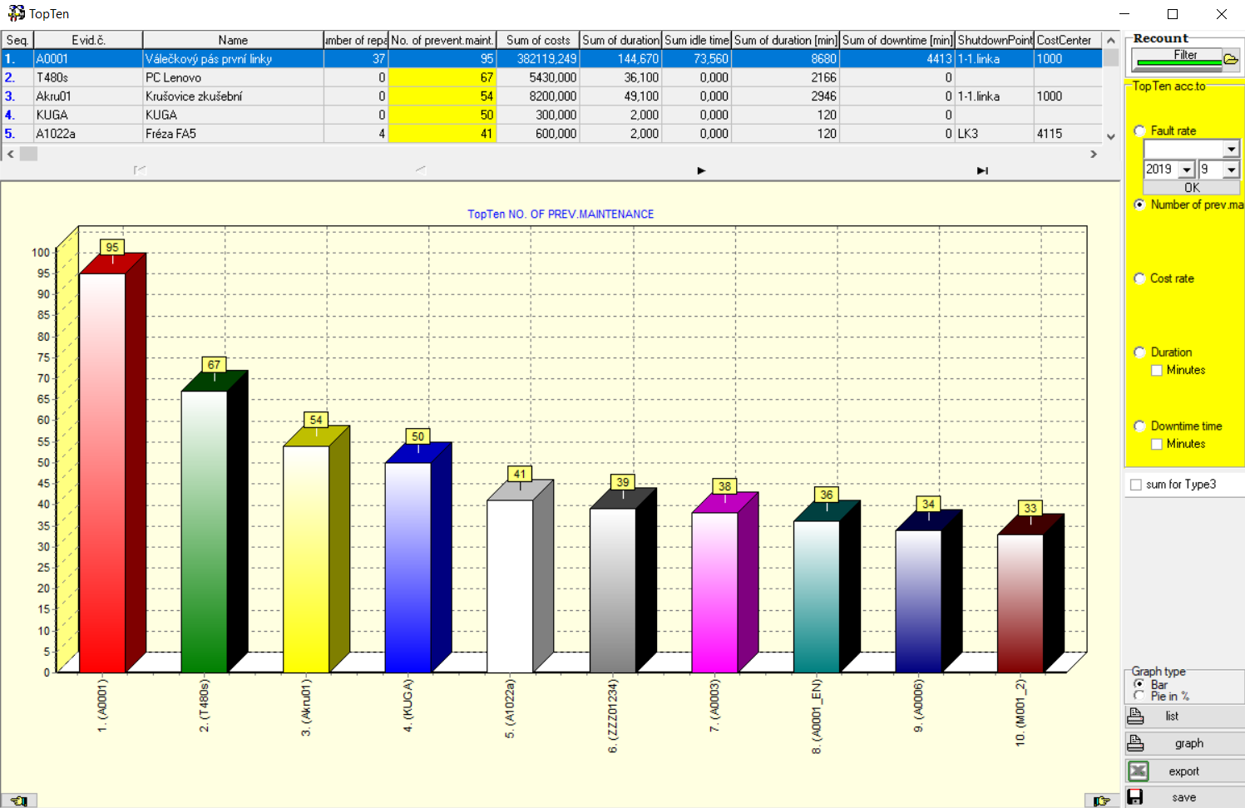
PRINTS / graPHS
Prints / Graphs
PROFYLAX offers tens of prints, synoptically listed. The prints are shown in the overview window before the printing starts. Some can be customised by users.
Printing to PDF without other applications is a matter of course.
Even more clearly
than clearly.
Thousands of varietes of print output can be filtered according to time period or other criteria. Graphic form enables Top Ten analyses (Fault rate, expense ratio, idle time interval …)

Slide 32
References
and experience
Automotive
Plastic production
Engineering
Packaging and paper industry
Food industry
Production for building and furniture industry
Health, sanitary and chemical industries
Electronics and electrical engineering…

Slide 33
Selected references
A list of a few businesses
Booster Precision Components (Beluša) s.r.o.
Booster Precision Components (Povazska Bystrica) s.r.o.
Craemer Slovakia s.r.o.
Gnotec Čadca s.r.o.
GPN GmbH - organizační složka Česká republika
Hitachi Cable Europe, s.r.o.
Mepla s.r.o. Mělník
MESIT foundry, a.s.
Mölnlycke Health Care ProcedurePak s.r.o. - Karviná
MORAVIA Stamping a.s.
Piston Rings Komarov s.r.o.
Pittsburgh Corning CR s.r.o. (FOAMGLAS)
Prettl Automotive Czech, s.r.o.
proseat Mladá Boleslav s.r.o.
PV-Czech, s.r.o.
SFS Group CZ s.r.o.
TAKATA Safety Systems Hungary Kft.
Váhala & spol. s r.o.
Yanfeng Czechia Automotive Interior Systems s.r.o. - Planá nad Lužnicí
1CSC PRECISION TUBES, a.s. Brno
AVX Mexico - Avio Excelente Juarez Chih
BORGERS CS spol. s r.o. - závody Rokycany, Hrádek, Volduchy
BWI Czech Republic s.r.o. Cheb
Carrier Commercial Refrigeration Russia Leshkovo
CARMAN, a.s Uničov
COLORprofi, spol. s.r.o. Boskovice
Dr.Oetker spol. s r.o. Kladno
Elektrokontakt, S de RL de CV Mexico, Nexans autoelectric group
EMCO spol.s r.o. Hrdly
Fiamm Automotive Czech a.s. Mladá Boleslav
FONS, spol. s r.o. Františkovy Lázně
HP-chemie Pelzer (UK) Ltd.Speke
INTEVA Products Czech Republic a.s. Liberec
ITW Slovakia s.r.o. Bytča (dříve TRW)
JOHNSON CONTROLS Námestovo
KOAM Elektronik s.r.o.
KPHN a.s. Kolín
LINDE + WIEMANN CZ, s.r.o. - závody
AGC Processing Teplice
ArcelorMittal Tubular Products Karviná
Autoneum CZ Hnátnice
BUKÓZA ENERGO Hencovce
CIREX CZ Kopřivnice
Gates Hydraulics
HANIL E-HWA Automotive Poland
IMI - Integrated Micro-Electronics Třemošná u Plzně
IVECO Czech Republic Vysoké Mýto
Josef Šebek - INTEBO, Zvole
Kovofiniš Ledeč nad Sázavou
KOYO Bearings Česká Republika
MAGNA Automotive (CZ) Chabařovice
MAGNA Automotive (CZ) Mladá Boleslav
M-E-P MEHLER ENGINEERED PRODUCTS Jilemnice
MERGON Corporation Anderson USA
MERGON International Castlepollard Irsko
NKT cables Velké Meziříčí

Slide 34
Thank you for your time
A Program for planning
and maintenance management
www.profylax.cz

